Slide 1

Personality Prediction via CV analysis and Pyschometirc Test
Designed and Developed By –
Shariq Shaikh
Pooja Ayre

Slide 2
Overview
PROBLEM STATEMENT
PROPOSED SOLUTION
APPROACH
DESIGN & ARCHITECTURE
FUTURE SCOPE
SUMMARY

Slide 3

PROBLEM STATEMENT
Recruiters skimming through resumes to assess candidates for pre-screening.
Time and Cost Involved in matching each resume with the skill mentioned in job description
Unable to gauge cultural fit for an organization based on resume
Unable to fill positions within the TAT due to resource capacity

Slide 4

PROPOSED SOLUTION
CV Parser to extract skills from a resume.
Personality detector based on psychometric test.
Saves cost up to 25% by minimizing the need of a resource to do pre-screening manually.
Helps in making faster and action driven decision.

Slide 5

APPROACH
An UI that will give an ability to upload a resume to the user.
A few bunch of questionnaire as a psychometric test to be answered by the user.
Upon submission, the screen popup the result and ability to download the same for the starters.

Slide 6
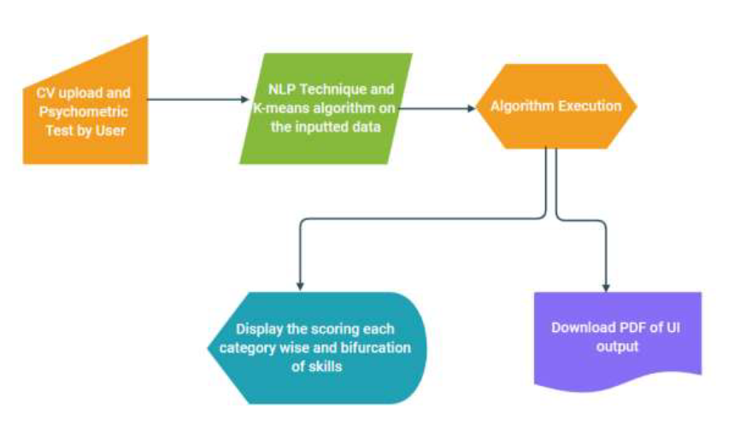

DESIGN & ARCHITECTURE

Slide 7
Future scope
An UI implementation to match job with resume skills.
Integrate a model with UI app to cover the scope.
Ability to send notifications to a recruiter about the results of their respective candidates.
Ensure that the selected candidates are highlighted and pipelines.

Slide 8
summary
Higher ROI.
Flexibility in the business process.
Smoother business operations.
Time and Cost-effective solution.

Slide 9

Thank you

